Slide 1


Market Intelligence data delivered by the Nielsen Portfolio
prepared for Myungin Baek from Innocean Seoul on 20/04/2020
"Understand the advertising around you to improve your own"

Slide 2
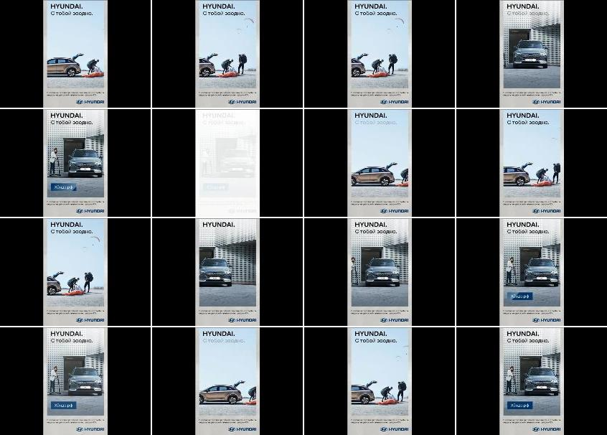
Hyundai Motors
Title: | The future of travel
Media: | Desktop
Description: | Not Available
Country: | Russia
Product: | Nexo hydrogen offroader/SUV
Category (Full Hierarchy): | AUTOMOTIVE | Cars | Cars Offroad Vehicle/SUV/4x4
Duration: | 1 image/s
Date From/To: | 14/04/2020
First URL: | mk.ru
Endline:
Creative ID: | 1249890601

Slide 3
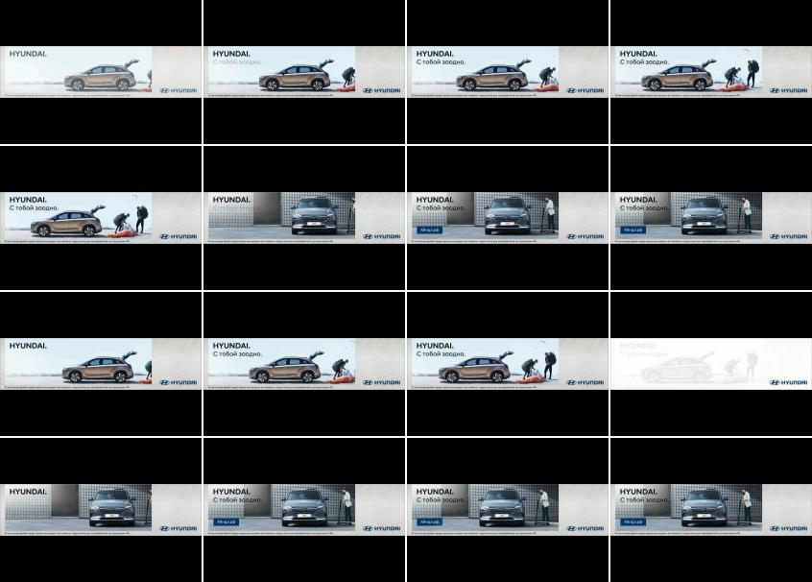
Hyundai Motors
Title: | The future of travel
Media: | Desktop
Description: | Not Available
Country: | Russia
Product: | Nexo hydrogen offroader/SUV
Category (Full Hierarchy): | AUTOMOTIVE | Cars | Cars Offroad Vehicle/SUV/4x4
Duration: | 1 image/s
Date From/To: | 14/04/2020
First URL: | mk.ru
Endline:
Creative ID: | 1249884801

Slide 4
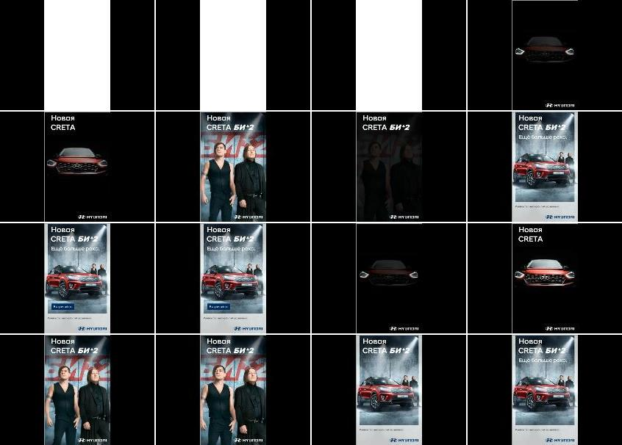
Hyundai Motors
Title: | New Hyundai Creta: specifications, price, buy, photo
Media: | Desktop
Description: | New Hyundai Creta: specifications, price, buy, photo
Country: | Russia
Product: | Creta offroader/SUV
Category (Full Hierarchy): | AUTOMOTIVE | Cars | Cars Offroad Vehicle/SUV/4x4
Duration: | 1 image/s
Date From/To: | 14/04/2020
First URL: | kp.ru
Endline:
Creative ID: | 1249883401

Slide 5
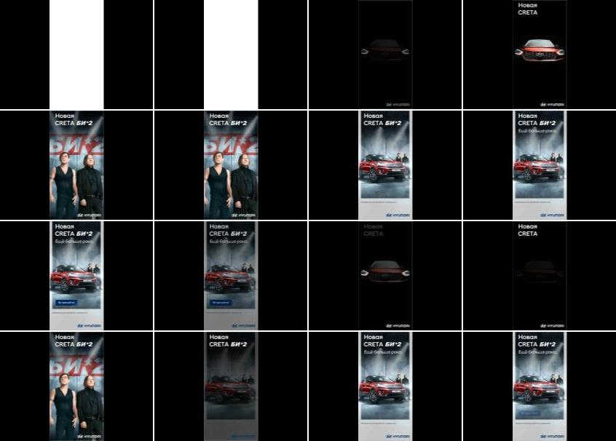
Hyundai Motors
Title: | New Hyundai Creta: specifications, price, buy, photo
Media: | Desktop
Description: | New Hyundai Creta: specifications, price, buy, photo
Country: | Russia
Product: | Creta offroader/SUV
Category (Full Hierarchy): | AUTOMOTIVE | Cars | Cars Offroad Vehicle/SUV/4x4
Duration: | 1 image/s
Date From/To: | 14/04/2020
First URL: | kp.ru
Endline:
Creative ID: | 1249879801

Slide 6
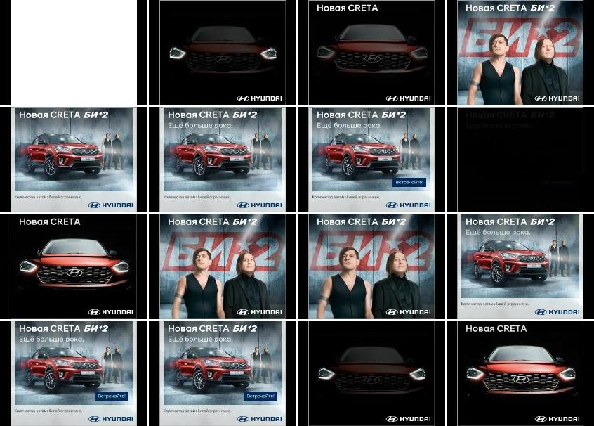
Hyundai Motors
Title: | New Hyundai Creta: specifications, price, buy, photo
Media: | Desktop
Description: | New Hyundai Creta: specifications, price, buy, photo
Country: | Russia
Product: | Creta offroader/SUV
Category (Full Hierarchy): | AUTOMOTIVE | Cars | Cars Offroad Vehicle/SUV/4x4
Duration: | 1 image/s
Date From/To: | 14/04/2020
First URL: | kp.ru
Endline:
Creative ID: | 1249880601

Slide 7
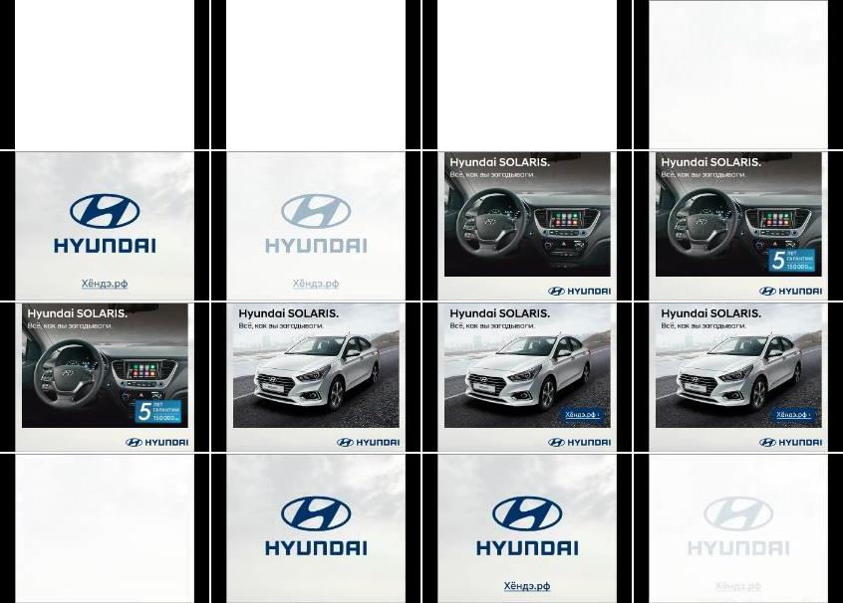
Hyundai Motors
Title: | Hyundai Solaris sedan: price, photos, buy, specifications, specifications
Media: | Desktop
Description: | Hyundai Solaris: review sedan, equipment prices, technical specifications car, photo passenger compartment. Where to buy Hyundai Solaris Russia?
Country: | Russia
Product: | Solaris saloon
Category (Full Hierarchy): | AUTOMOTIVE | Cars | Cars Medium
Duration: | 1 image/s
Date From/To: | 01/04/2020
First URL: | zr.ru
Endline:
Creative ID: | 1248221401

Slide 8
Hyundai Motors
Title: | The future of travel
Media: | Desktop
Description: | Not Available
Country: | Russia
Product: | car range/corporate
Category (Full Hierarchy): | AUTOMOTIVE | Cars | Cars Corporate/Range
Duration: | 1 image/s
Date From/To: | 17/03/2020
First URL: | gazeta.ru
Endline:
Creative ID: | 1246498001

Slide 9

Hyundai Motors
Title: | The future of travel
Media: | Desktop
Description: | Not Available
Country: | Russia
Product: | car range/corporate
Category (Full Hierarchy): | AUTOMOTIVE | Cars | Cars Corporate/Range
Duration: | 1 image/s
Date From/To: | 21/02/2020
First URL: | rambler.ru
Endline:
Creative ID: | 1240412601

Slide 10

Hyundai Motors
Title: | The future of travel
Media: | Desktop
Description: | Not Available
Country: | Russia
Product: | car range/corporate
Category (Full Hierarchy): | AUTOMOTIVE | Cars | Cars Corporate/Range
Duration: | 1 image/s
Date From/To: | 12/02/2020
First URL: | mk.ru
Endline:
Creative ID: | 1235916301

Slide 11
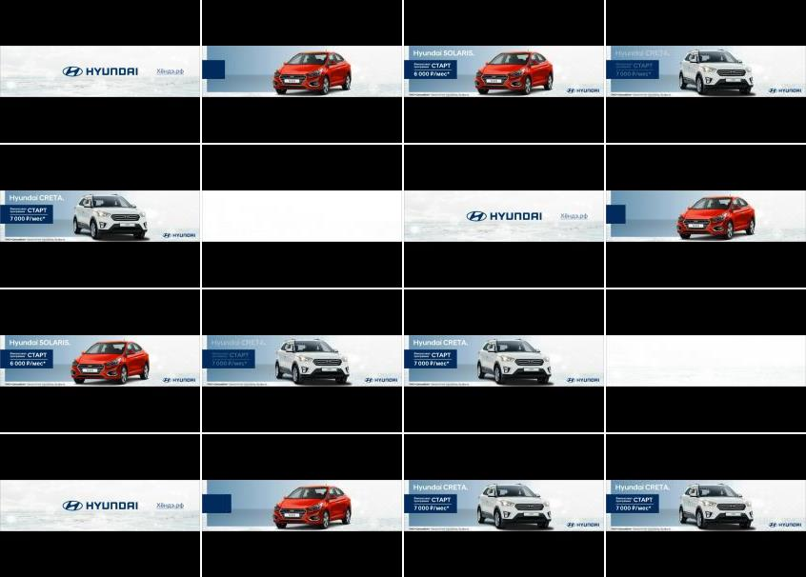
Hyundai Motors
Title: | Start
Media: | Desktop
Description: | Not Available
Country: | Russia
Product: | car range/corporate
Category (Full Hierarchy): | AUTOMOTIVE | Cars | Cars Corporate/Range
Duration: | 1 image/s
Date From/To: | 08/02/2020
First URL: | allwomens.ru
Endline:
Creative ID: | 1235149501

Slide 12
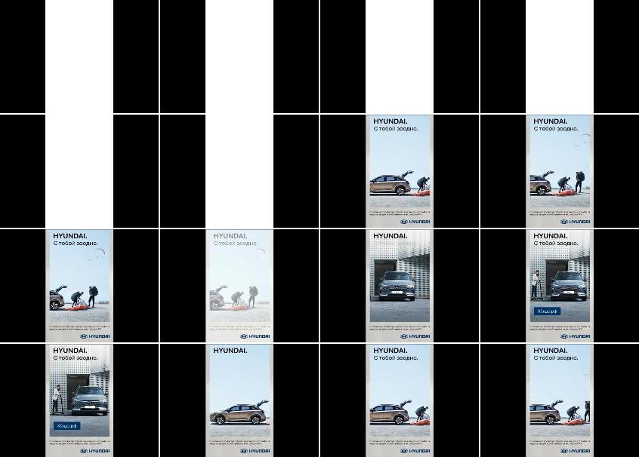
Hyundai Motors
Title: | The future of travel
Media: | Desktop
Description: | Not Available
Country: | Russia
Product: | car range/corporate
Category (Full Hierarchy): | AUTOMOTIVE | Cars | Cars Corporate/Range
Duration: | 1 image/s
Date From/To: | 01/02/2020
First URL: | kp.ru
Endline:
Creative ID: | 1234587101

Slide 13

Hyundai Motors
Title: | Hyundai: model range, prices for cars, where to buy Hyundai
Media: | Desktop
Description: | Hyundai official site: models current prices, reviews car photos, news, recording for test drive. Hurry to buy new Hyundai!
Country: | Russia
Product: | car range/corporate
Category (Full Hierarchy): | AUTOMOTIVE | Cars | Cars Corporate/Range
Duration: | 1 image/s
Date From/To: | 29/01/2020
First URL: | russianfood.com
Endline:
Creative ID: | 1233190301

Slide 14
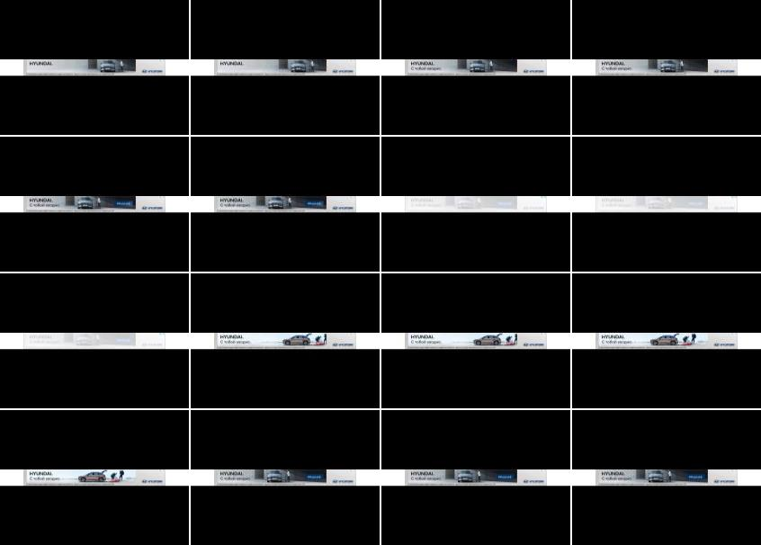
Hyundai Motors
Title: | The future of travel
Media: | Desktop
Description: | Not Available
Country: | Russia
Product: | car range/corporate
Category (Full Hierarchy): | AUTOMOTIVE | Cars | Cars Corporate/Range
Duration: | 1 image/s
Date From/To: | 28/01/2020
First URL: | rambler.ru
Endline:
Creative ID: | 1233029501

Slide 15
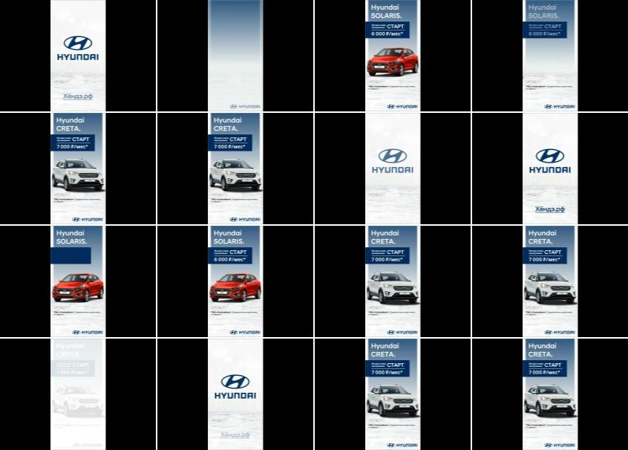
Hyundai Motors
Title: | -
Media: | Desktop
Description: | Not Available
Country: | Russia
Product: | car range/corporate
Category (Full Hierarchy): | AUTOMOTIVE | Cars | Cars Corporate/Range
Duration: | 1 image/s
Date From/To: | 28/01/2020
First URL: | rambler.ru
Endline:
Creative ID: | 1233189801

Slide 16
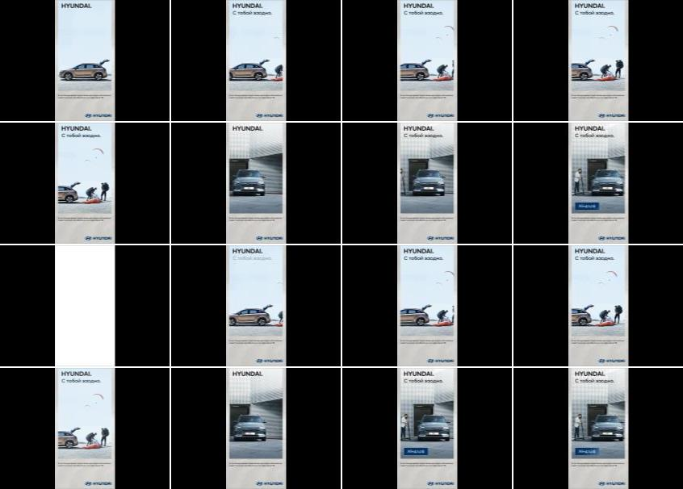
Hyundai Motors
Title: | The future of travel
Media: | Desktop
Description: | Not Available
Country: | Russia
Product: | car range/corporate
Category (Full Hierarchy): | AUTOMOTIVE | Cars | Cars Corporate/Range
Duration: | 1 image/s
Date From/To: | 25/01/2020
First URL: | rambler.ru
Endline:
Creative ID: | 1233028601

Slide 17
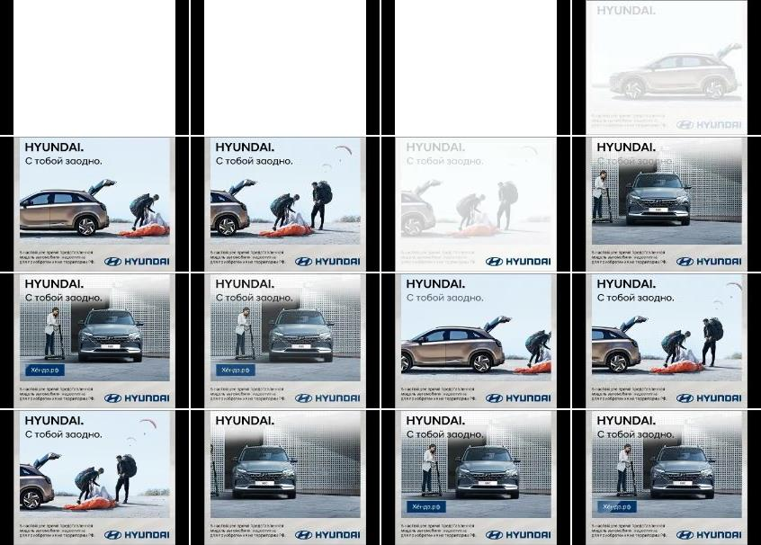
Hyundai Motors
Title: | The future of travel
Media: | Desktop
Description: | Not Available
Country: | Russia
Product: | car range/corporate
Category (Full Hierarchy): | AUTOMOTIVE | Cars | Cars Corporate/Range
Duration: | 1 image/s
Date From/To: | 24/01/2020
First URL: | rambler.ru
Endline:
Creative ID: | 1233028101

Slide 18
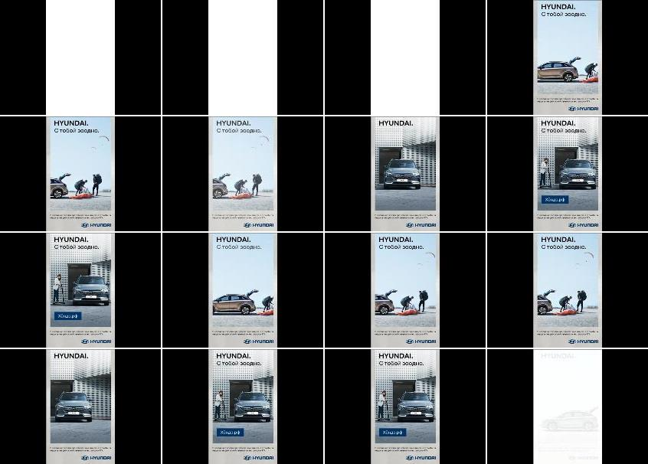
Hyundai Motors
Title: | The future of travel
Media: | Desktop
Description: | Not Available
Country: | Russia
Product: | car range/corporate
Category (Full Hierarchy): | AUTOMOTIVE | Cars | Cars Corporate/Range
Duration: | 1 image/s
Date From/To: | 24/01/2020
First URL: | rambler.ru
Endline:
Creative ID: | 1233028301

Slide 19
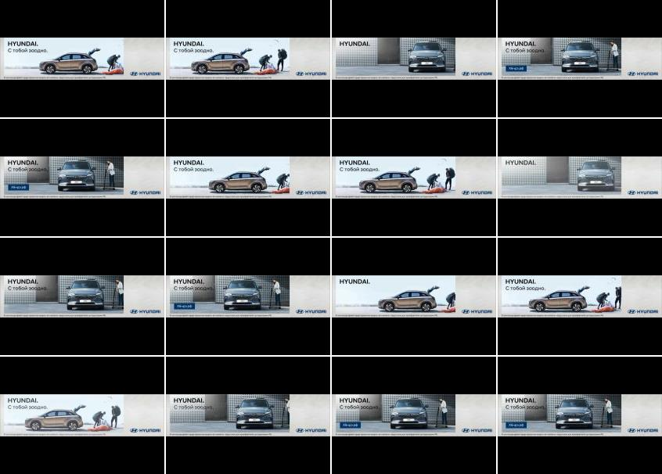
Hyundai Motors
Title: | Not Available
Media: | Desktop
Description: | Not Available
Country: | Russia
Product: | car range/corporate
Category (Full Hierarchy): | AUTOMOTIVE | Cars | Cars Corporate/Range
Duration: | 1 image/s
Date From/To: | 24/01/2020
First URL: | rambler.ru
Endline:
Creative ID: | 1232472501

Slide 20
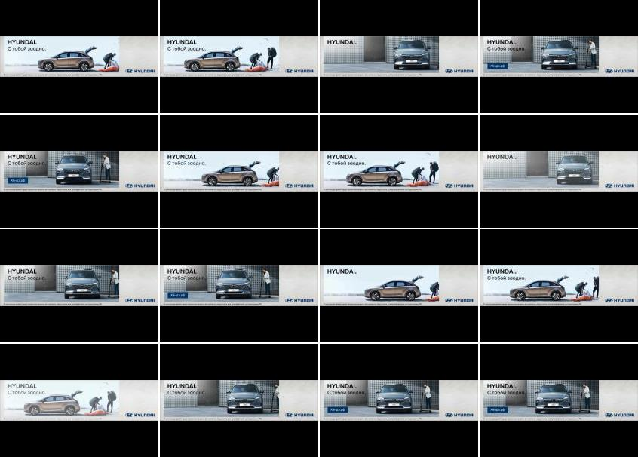
Hyundai Motors
Title: | The future of travel
Media: | Desktop
Description: | Not Available
Country: | Russia
Product: | car range/corporate
Category (Full Hierarchy): | AUTOMOTIVE | Cars | Cars Corporate/Range
Duration: | 1 image/s
Date From/To: | 24/01/2020
First URL: | rambler.ru
Endline:
Creative ID: | 1232473001

Slide 21
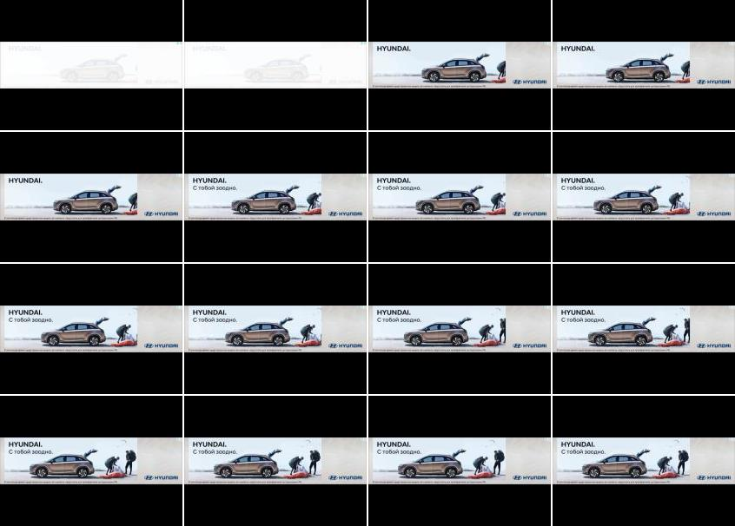
Hyundai Motors
Title: | The future of travel
Media: | Desktop
Description: | Not Available
Country: | Russia
Product: | car range/corporate
Category (Full Hierarchy): | AUTOMOTIVE | Cars | Cars Corporate/Range
Duration: | 1 image/s
Date From/To: | 19/01/2020
First URL: | rambler.ru
Endline:
Creative ID: | 1231255901

Slide 22
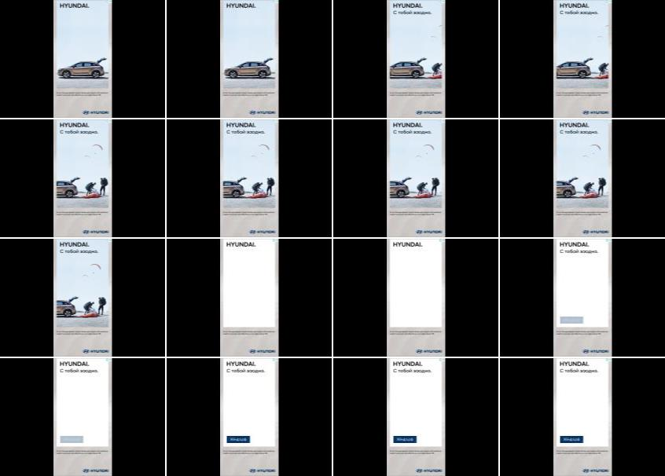
Hyundai Motors
Title: | Hyundai: model range, prices for cars, where to buy Hyundai
Media: | Desktop
Description: | Hyundai official site: models current prices, reviews car photos, news, recording for test drive. Hurry to buy new Hyundai!
Country: | Russia
Product: | car range/corporate
Category (Full Hierarchy): | AUTOMOTIVE | Cars | Cars Corporate/Range
Duration: | 1 image/s
Date From/To: | 17/01/2020
First URL: | russianfood.com
Endline:
Creative ID: | 1233187801

Slide 23
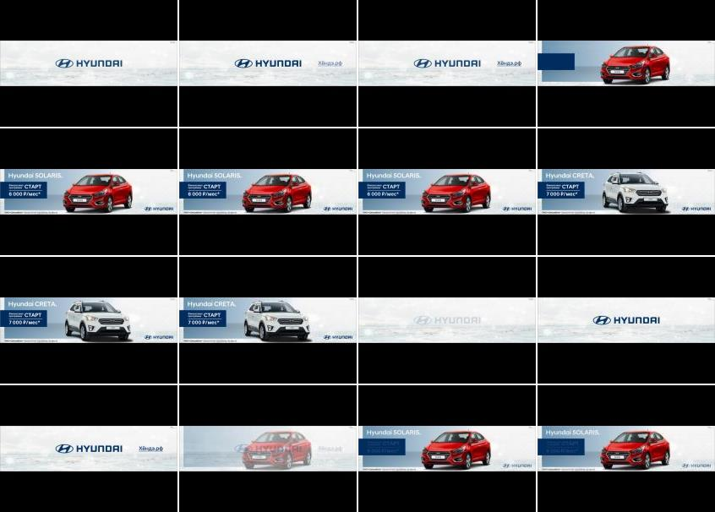
Hyundai Motors
Title: | Start
Media: | Desktop
Description: | Not Available
Country: | Russia
Product: | car range/corporate
Category (Full Hierarchy): | AUTOMOTIVE | Cars | Cars Corporate/Range
Duration: | 1 image/s
Date From/To: | 15/01/2020
First URL: | kommersant.ru
Endline:
Creative ID: | 1230367801

Slide 24

Hyundai Motors
Title: | Hyundai: lineup, car prices, where to buy Hyundai
Media: | Desktop
Description: | Not Available
Country: | Russia
Product: | offroader/SUV range
Category (Full Hierarchy): | AUTOMOTIVE | Cars | Cars Offroad Vehicle/SUV/4x4
Duration: | 1 image/s
Date From/To: | 24/12/2019
First URL: | baby.ru
Endline:
Creative ID: | 1227621201

Slide 25
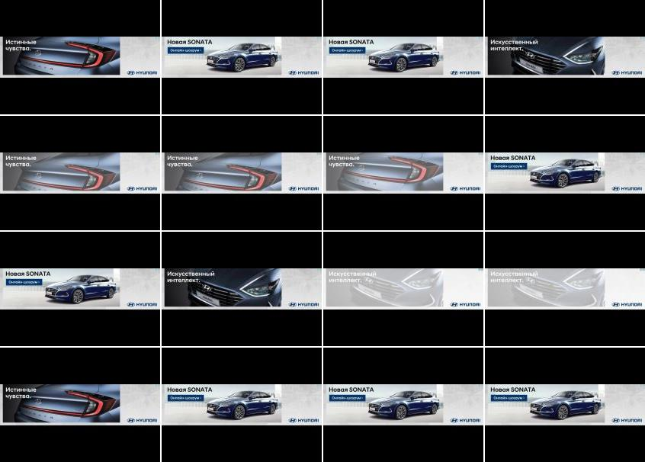
Hyundai Motors
Title: | Sonata
Media: | Desktop
Description: | Hyundai
Country: | Russia
Product: | Sonata saloon
Category (Full Hierarchy): | AUTOMOTIVE | Cars | Cars Medium
Duration: | 1 image/s
Date From/To: | 27/11/2019
First URL: | allwomens.ru
Endline:
Creative ID: | 1222440001

Slide 26

Hyundai Motors
Title: | Hyundai: model range, prices for cars, where to buy Hyundai
Media: | Desktop
Description: | Hyundai official site: models current prices, reviews car photos, news, recording for test drive. Hurry to buy new Hyundai!
Country: | Russia
Product: | car range/corporate
Category (Full Hierarchy): | AUTOMOTIVE | Cars | Cars Corporate/Range
Duration: | 1 image/s
Date From/To: | 10/11/2019
First URL: | mk.ru
Endline:
Creative ID: | 1208555301

Slide 27
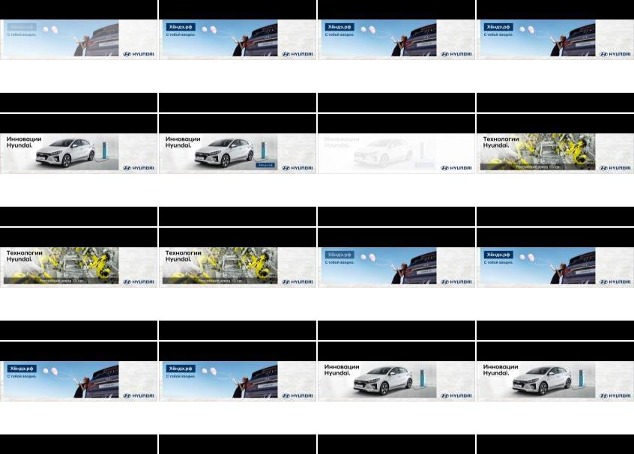
Hyundai Motors
Title: | Hyundai: model range, prices for cars, where to buy Hyundai
Media: | Desktop
Description: | Hyundai official site: models current prices, reviews car photos, news, recording for test drive. Hurry to buy new Hyundai!
Country: | Russia
Product: | car range/corporate
Category (Full Hierarchy): | AUTOMOTIVE | Cars | Cars Corporate/Range
Duration: | 1 image/s
Date From/To: | 08/10/2019
First URL: | rambler.ru
Endline:
Creative ID: | 1199534301

Slide 28
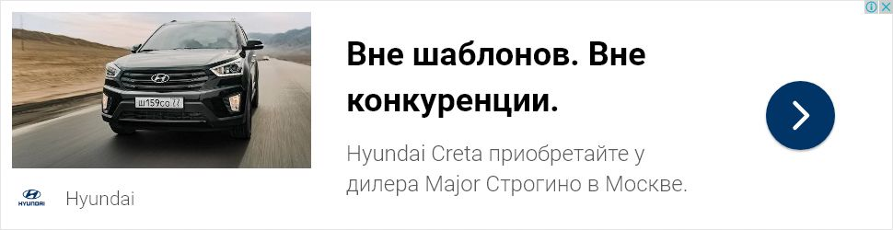
Hyundai Motors
Title: | -
Media: | Desktop
Description: | description
Country: | Russia
Product: | Creta offroader/SUV
Category (Full Hierarchy): | AUTOMOTIVE | Cars | Cars Offroad Vehicle/SUV/4x4
Duration: | 1 image/s
Date From/To: | 06/10/2019
First URL: | rambler.ru
Endline:
Creative ID: | 1198674301

Slide 29
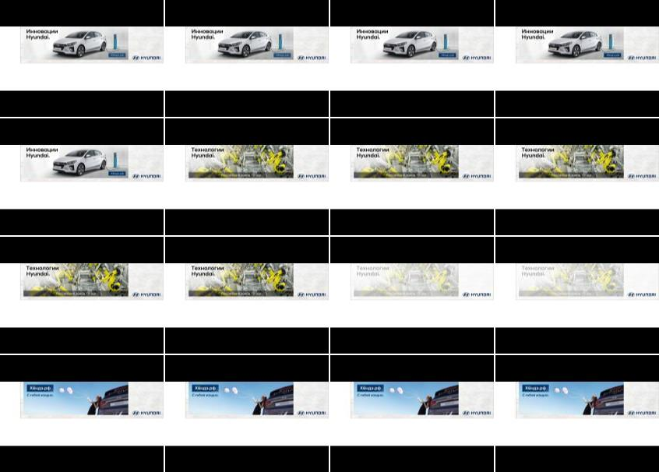
Hyundai Motors
Title: | Hyundai: model range, prices for cars, where to buy Hyundai
Media: | Desktop
Description: | Hyundai official site: models current prices, reviews car photos, news, recording for test drive. Hurry to buy new Hyundai!
Country: | Russia
Product: | car range/corporate
Category (Full Hierarchy): | AUTOMOTIVE | Cars | Cars Corporate/Range
Duration: | 1 image/s
Date From/To: | 05/10/2019
First URL: | rambler.ru
Endline:
Creative ID: | 1198627601

Slide 30
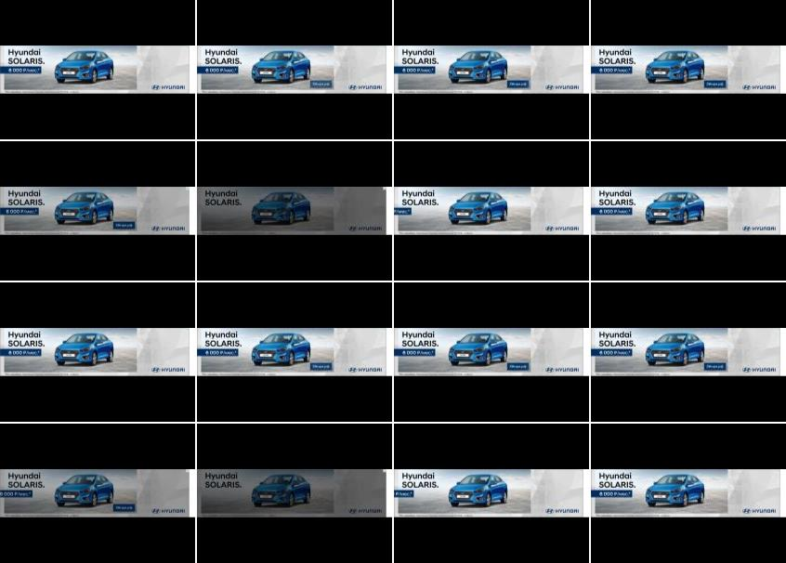
Hyundai Motors
Title: | Hyundai Solaris : , , , ,
Media: | Desktop
Description: | Hyundai Solaris: , , , . Hyundai Solaris ?
Country: | Russia
Product: | Solaris saloon
Category (Full Hierarchy): | AUTOMOTIVE | Cars | Cars Medium
Duration: | 1 image/s
Date From/To: | 04/10/2019
First URL: | vibirai.ru
Endline:
Creative ID: | 1198476401

Slide 31
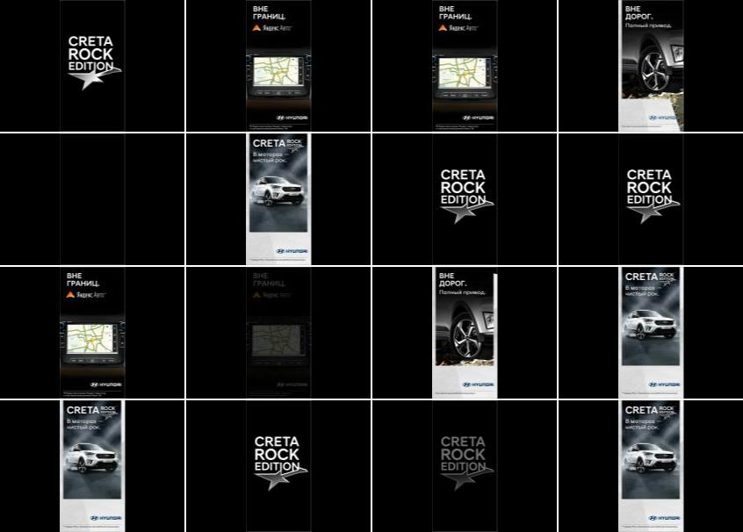
Hyundai Motors
Title: | Warning
Media: | Desktop
Description: | Not Available
Country: | Russia
Product: | Creta offroader/SUV
Category (Full Hierarchy): | AUTOMOTIVE | Cars | Cars Offroad Vehicle/SUV/4x4
Duration: | 1 image/s
Date From/To: | 03/10/2019
First URL: | gismeteo.ru
Endline:
Creative ID: | 1198467201

